Slide 1


“Are men looking for similar dating partner?”
An Analysis of Speed Dating Dataset
Presented By Aarushi Mishra (# 16)

Slide 2
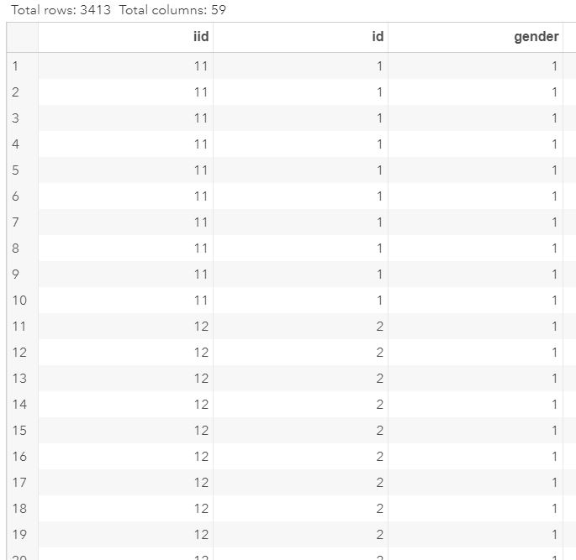
Data Description
The Speed Dating – Male dataset consist of 3413 observations and 59 variables, in total
For analysis, I used the data corresponding to 22 males who signed-up for the event
In addition to many other details, event authorities asked each participant to mention the qualities they are looking for in the opposite sex
Each participant was asked to distribute points out of 100 among the desired qualities
…
. . .

Slide 3
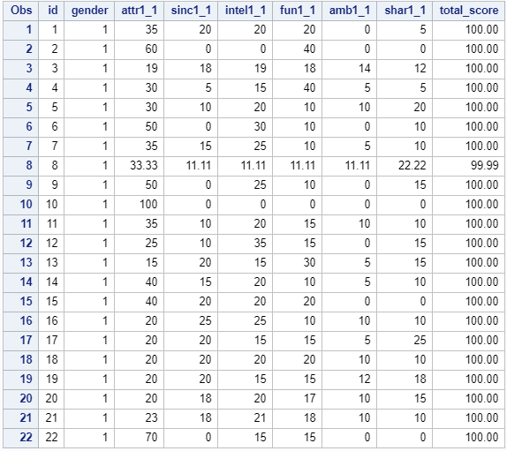
Data Description
These qualities include:
Attractiveness attr1_1
Sincerity sinc1_1
Intelligence intel1_1
Fun fun1_1
Ambitious amb1_1
Shared Interests shar1_1
After sorting the data suitably, the final data looks like this

Slide 4


Objective of Analysis
Based on the points distribution for these 6 qualities, perform clustering of observations
Infer if there is any pattern in the way the observations are clustered
Answer the question of analysis:
“ Are men looking for similar dating partners?”

Slide 5

SAS Procedures Used
PROC IMPORT
PRIC PRINT
PROC CLUSTER
PROC TREE
PROC SORT
PROC TABULATE
PROC MEANS

Slide 6
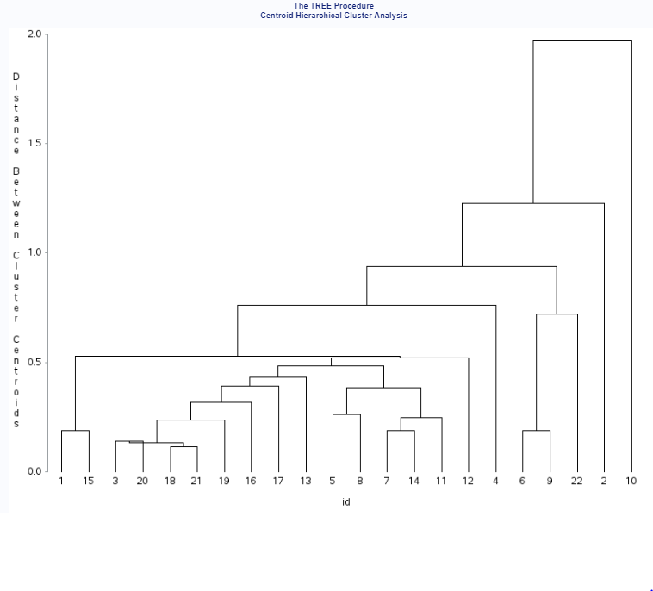
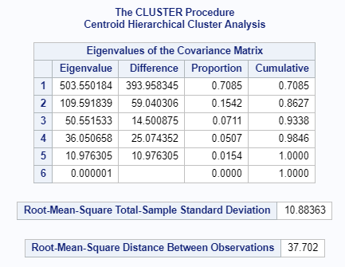
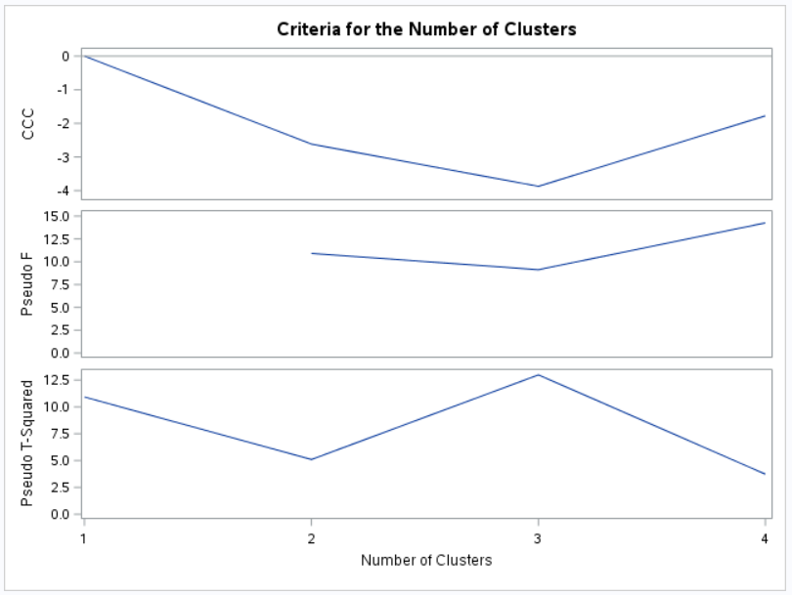




SAS Output

Slide 7
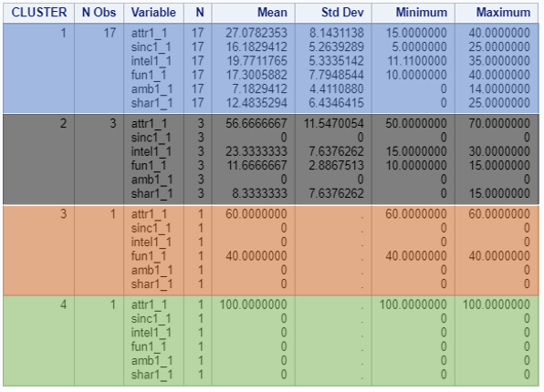
SAS Output
While most of the subjects are looking for a combination of attributes, few of them have rated few attributes to be absolutely more desirable over the others
Cluster 1: men looking for combination of attributes but most desired one is attractiveness and least is ambitious
Cluster 2: men do not desire for sincerity and sharing at all, attractiveness is highly rated!!
Cluster 3 : 1 person who wants partner to be attractive and fun loving only
Cluster 4: 1 person who desires for only good looks

Slide 8


Conclusion
All the subjects can be broadly divided into 4 clusters / groups
Out of 6 qualities, “attractiveness” is highest rated quality that men are looking for, followed by “intelligence”
Majority of the subjects belong to one cluster
“Yes, most of the men are looking for similar dating partners!”

Slide 9

Thank You

Slide 10
Questions / Feedback?

